Slide 1
Formal Relational Query Languages
Two mathematical Query Languages form the basis for “real” languages (e.g. SQL), and for implementation:
  Relational Algebra: More operational, very useful for representing execution plans.
  Relational Calculus: Lets users describe what they want, rather than how to compute it. (Non-operational, declarative.)
Slide No:L6-1

Slide 2
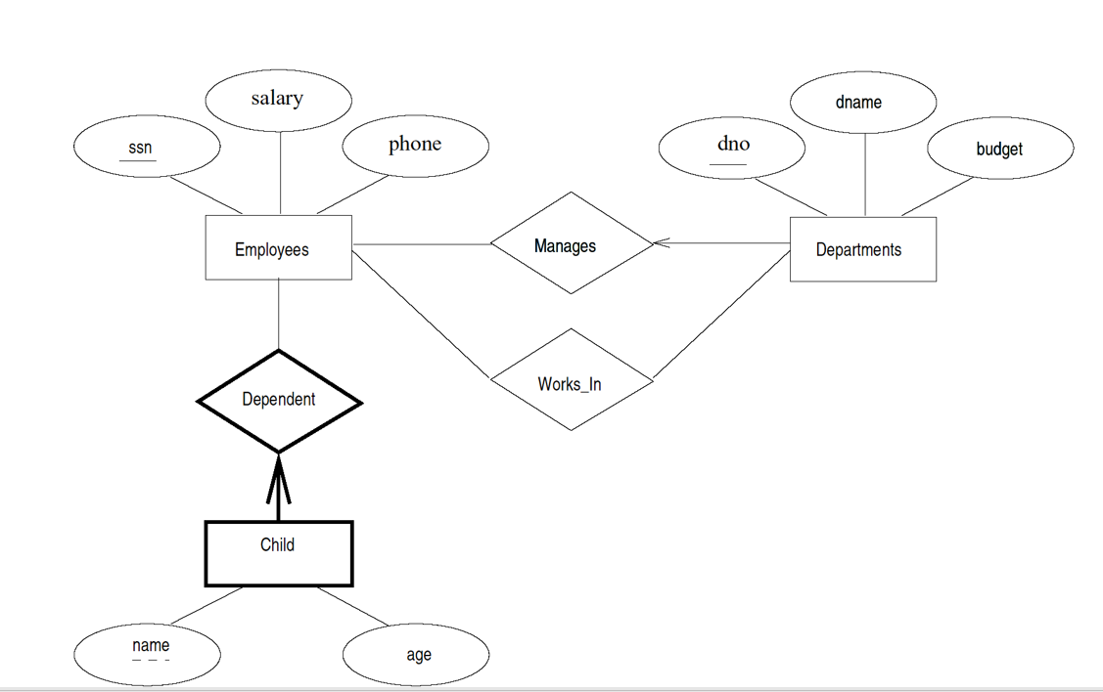

Slide 3
Preliminaries
A query is applied to relation instances, and the result of a query is also a relation instance.
  Schemas of input relations for a query are fixed (but query will run regardless of instance!)
  The schema for the result of a given query is also fixed! Determined by definition of query language constructs.
Positional vs. named-field notation:
  Positional notation easier for formal definitions, named-field notation more readable.
  Both used in SQL
Slide No:L6-2
Notes:
4

Slide 4
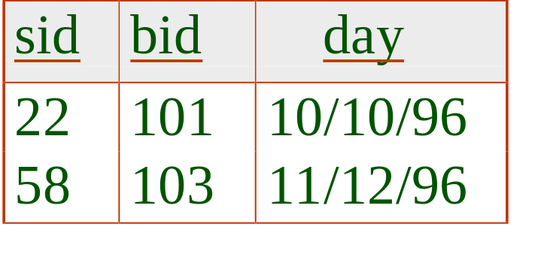
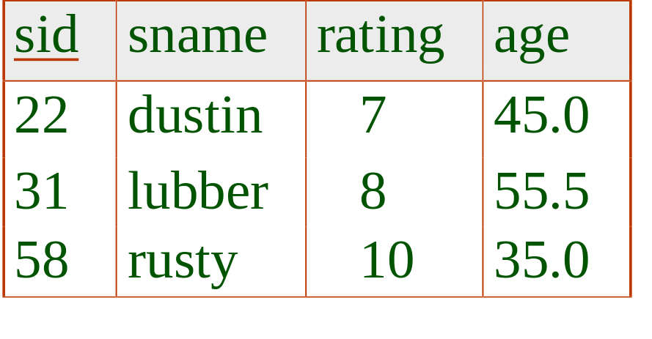
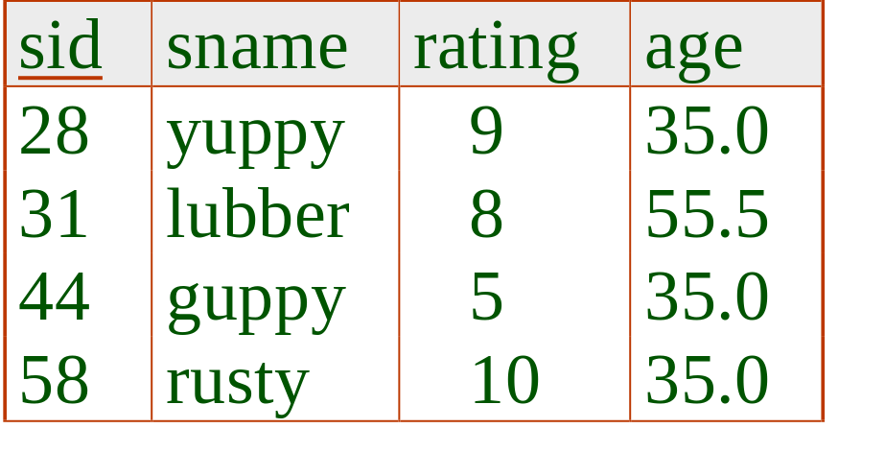
Example Instances
R1
“Sailors” and “Reserves” relations for our examples.
We’ll use positional or named field notation, assume that names of fields in query results are `inherited’ from names of fields in query input relations.
S1
S2
Slide No:L6-3
Notes:
5

Slide 5
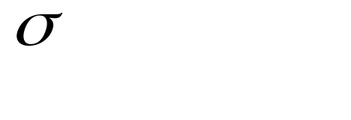
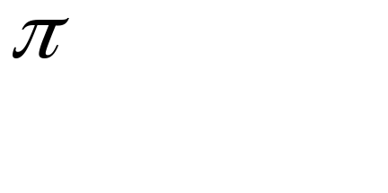



Relational Algebra
Basic operations:
  Selection ( ) Selects a subset of rows from relation.
  Projection ( ) Deletes unwanted columns from relation.
  Cross-product ( ) Allows us to combine two relations.
  Set-difference ( ) Tuples in reln. 1, but not in reln. 2.
  Union ( ) Tuples in reln. 1 and in reln. 2.
Additional operations:
  Intersection, join, division, renaming: Not essential, but (very!) useful.
Since each operation returns a relation, operations can be composed! (Algebra is “closed”.)
Slide No:L6-4
Notes:
6

Slide 6
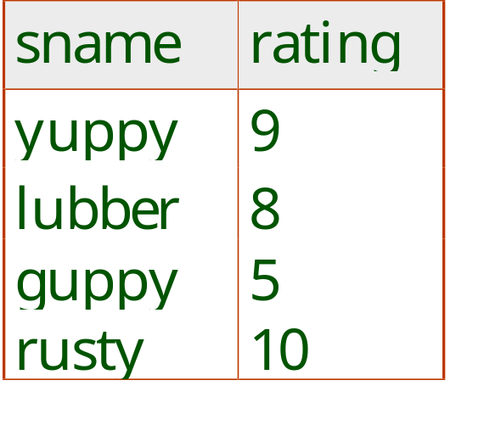
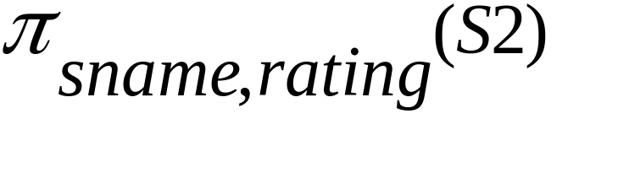
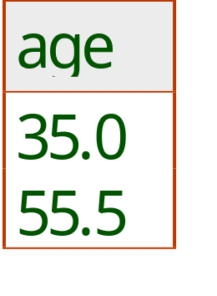
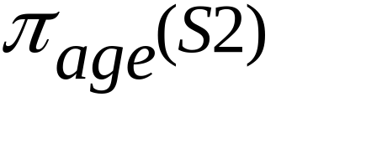
Projection
Deletes attributes that are not in projection list.
Schema of result contains exactly the fields in the projection list, with the same names that they had in the (only) input relation.
Projection operator has to eliminate duplicates! (Why??)
  Note: real systems typically don’t do duplicate elimination unless the user explicitly asks for it. (Why not?)
Slide No:L6-5
Notes:
7

Slide 7
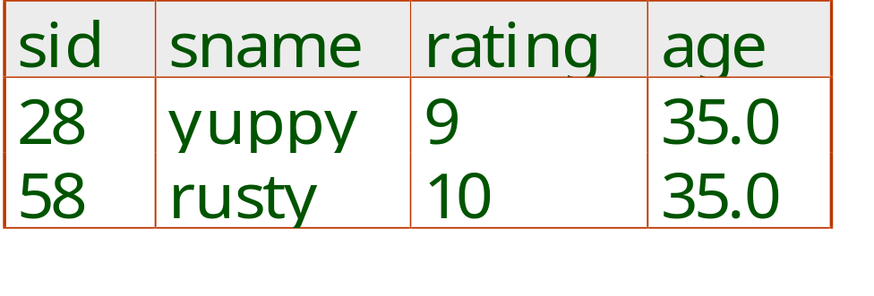
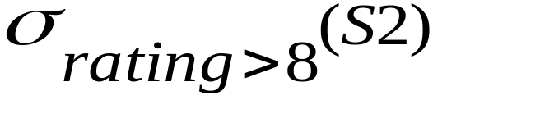
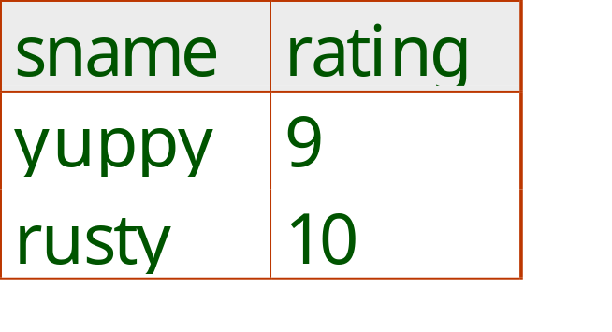
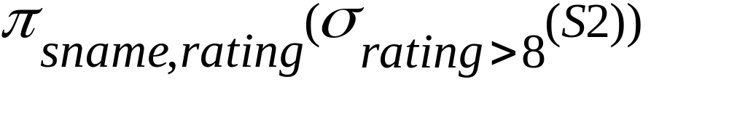
Selection
Selects rows that satisfy selection condition.
No duplicates in result! (Why?)
Schema of result identical to schema of (only) input relation.
Result relation can be the input for another relational algebra operation! (Operator composition.)
Slide No:L6-6
Notes:
8

Slide 8
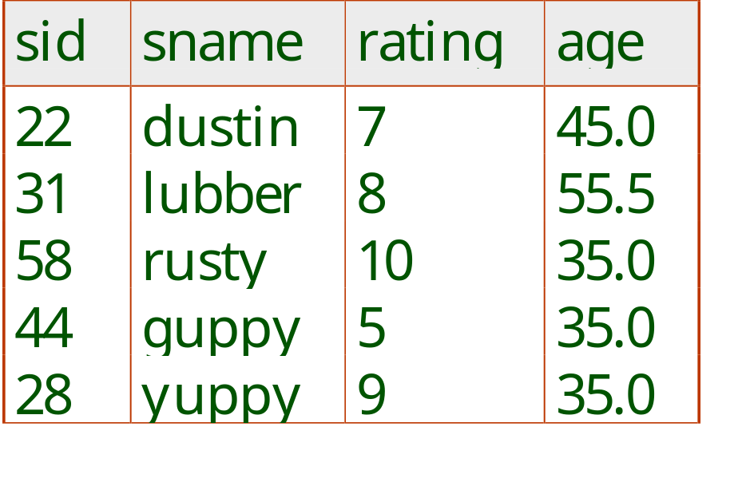
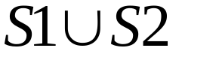
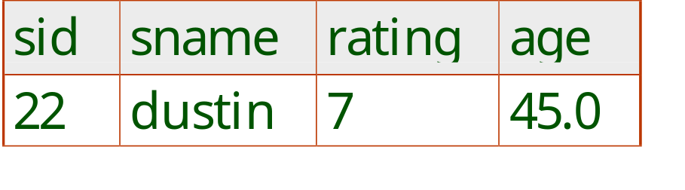
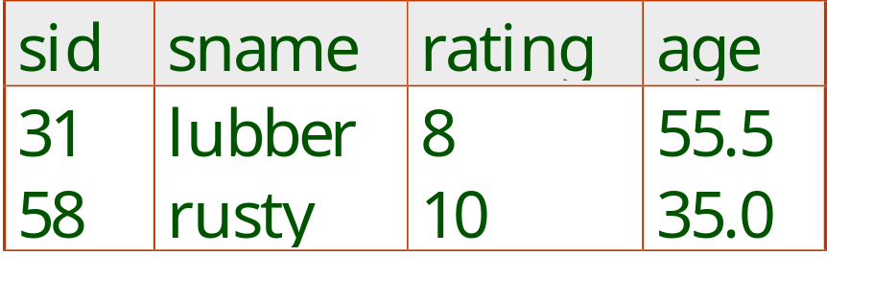

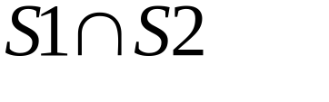
Union, Intersection, Set-Difference
All of these operations take two input relations, which must be union-compatible:
  Same number of fields.
  `Corresponding’ fields have the same type.
What is the schema of result?
Slide No:L6-7
Notes:
9

Slide 9
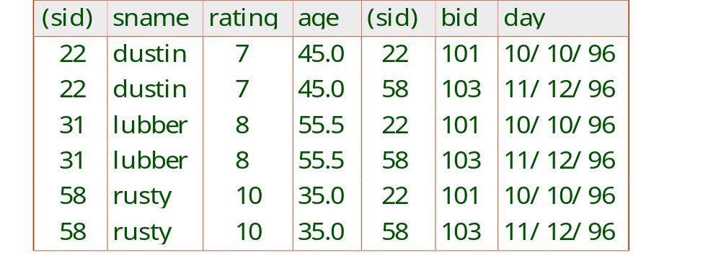
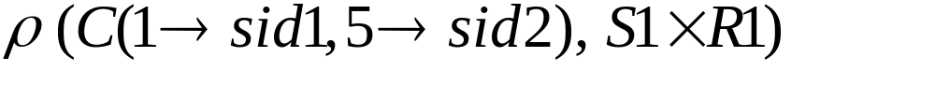
Cross-Product
Each row of S1 is paired with each row of R1.
Result schema has one field per field of S1 and R1, with field names `inherited’ if possible.
  Conflict: Both S1 and R1 have a field called sid.
Renaming operator:
Slide No:L6-8
Notes:
10

Slide 10
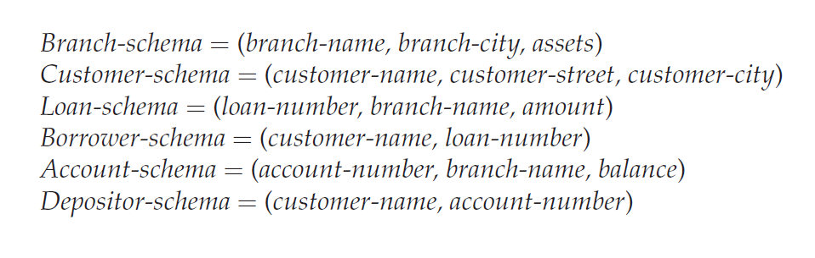
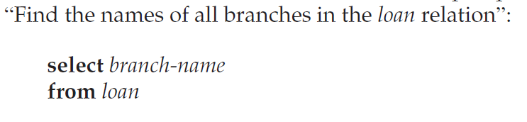
SQL clauses
Select Clause:

Slide 11
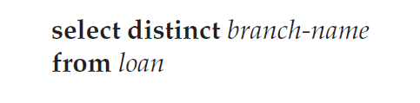
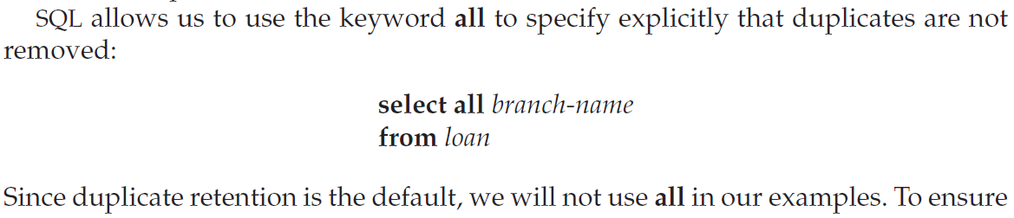
Select clause
To eliminate the duplicate values from the display
To keep all duplicate values

Slide 12
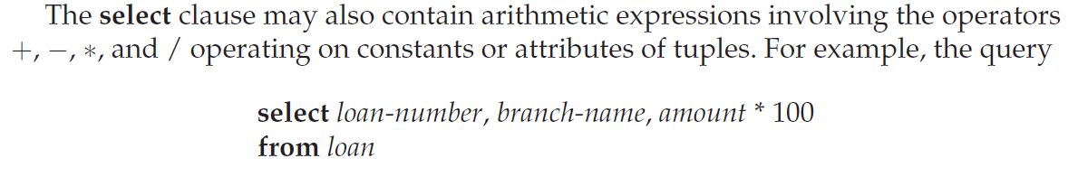
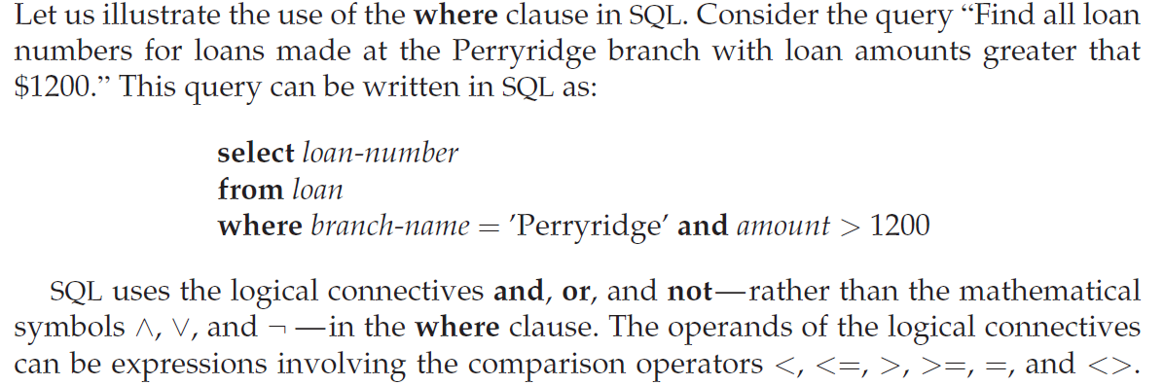
Use of Arithmetic operators
Where clause:

Slide 13
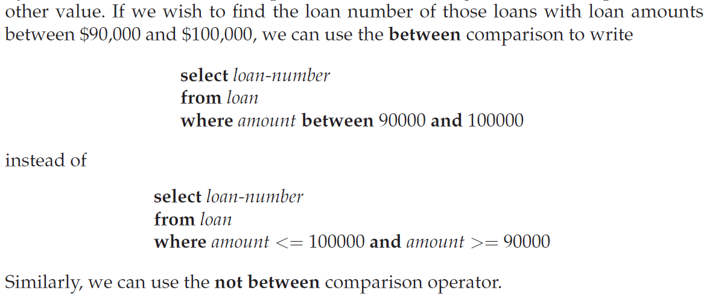
Between & and operator

Slide 14
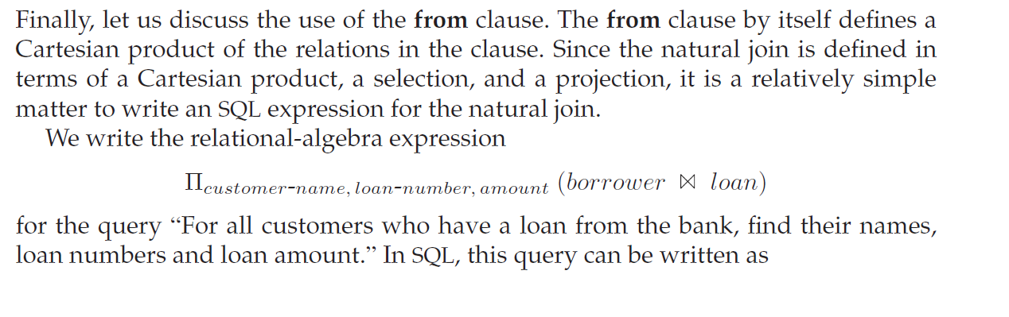

FROM Clause

Slide 15

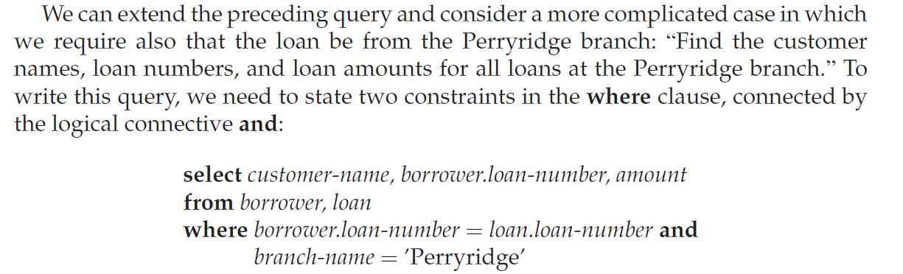
Use of And in Where clause

Slide 16
Use of Rename operation
To Rename the column name in the display we can use AS
SQL> select sname as student_name from student;

Slide 17
Relational Calculus
Comes in two flavors: Tuple relational calculus (TRC) and Domain relational calculus (DRC).
Calculus has variables, constants, comparison ops, logical connectives and quantifiers.
  TRC: Variables range over (i.e., get bound to) tuples.
  DRC: Variables range over domain elements (= field values).
  Both TRC and DRC are simple subsets of first-order logic.
Expressions in the calculus are called formulas. An answer tuple is essentially an assignment of constants to variables that make the formula evaluate to true.
Slide No:L7-1

Slide 18
Tuple Relational calculus
The tuple relational calculus, by contrast, is a nonprocedural query language. It describes the desired information without giving a specific procedure for obtaining that information.
A query in the tuple relational calculus is expressed as
{t | P(t)}
that is, it is the set of all tuples t such that predicate P is true for t.
where P is a formula. Several tuple variables may appear in a formula.
A tuple variable is said to be a free variable unless it is quantified by a ∃ or ∀.
Thus, in t ∈ loan ∧ ∃ s ∈ customer (t[branch-name] = s[branch-name])

Slide 19
Example Queries
Say that we want to find the branch-name, loan-number, and amount for loans of over $1200:
{t | t ∈ loan ∧ t[amount] > 1200}

Slide 20
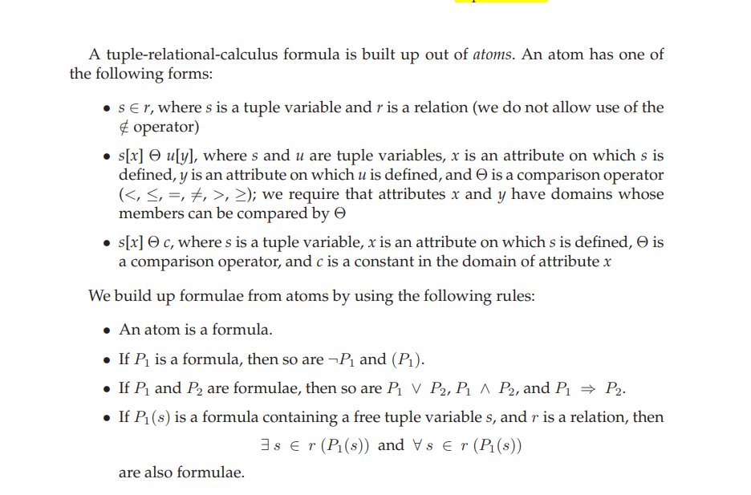

Slide 21
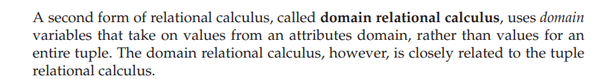
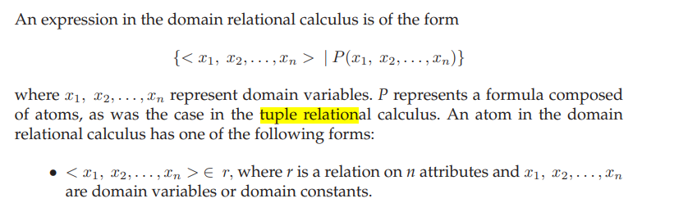
Domain Relational Calculus

Slide 22
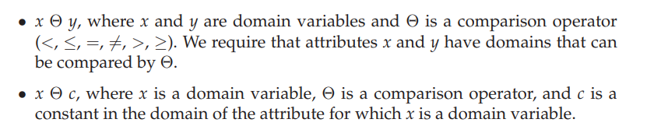

Slide 23
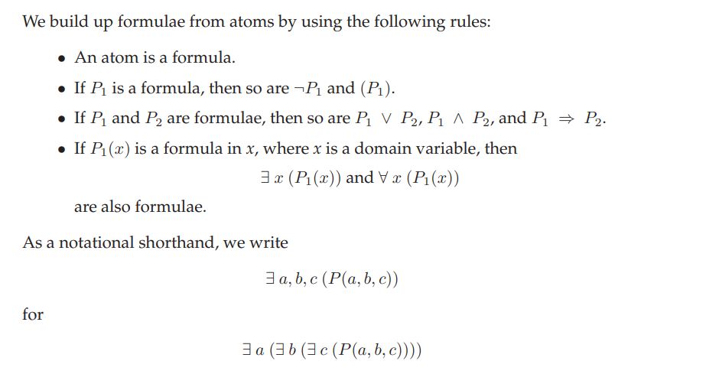

Slide 24
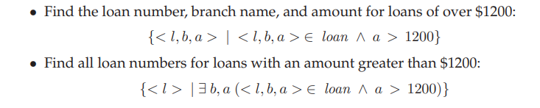
Domain Relational calculus

